Slide 1

Tentative Title: Damage Detection & Classification
of Fruit Using Image Processing Technique
Supervised by
Sadia Jahan
Lecturer
Department of CSE, City University
Presented by
SL. NO. | NAME | ID | BATCH | DEPT.
01 | Md. Emran Hasan | 152392002 | 39th | CSE
02 | Saiful Islam Sajon | 152392317 | 39th | CSE

Slide 2

Presentation Outline
1. Introduction
2. Motivation
3. Objectives
4. Applications
5. Contribution
6. Related works
7. Proposed framework
8. Future work
9. Conclusion
10. References
Picture courtesy: Preparation Outline, Pi4i.com

Slide 3
Abstract
The food processing industry have been working with different kind of fruits. Most of the industries who are classifying the classes and the damages of fruit by manual. As a result of manual classification it will become a challenging task for human being. So, in this research work we are going to develop a model for automatic fruit identification and damage detection based on Machine learning and Image processing technique.

Slide 4
Introduction
Image Detection: Image or Object Detection is a computer technology that processes the image and detects objects in it. People often confuse Image Detection with Image Classification. Although the difference is rather clear. If we need to classify image items, we use Classification. But if we just need to locate them, for example, find out the number of objects in the picture, we should use Image Detection.
Image Classification: It is a process of labeling objects in the image – sorting them by certain classes. For example, ask Google to find pictures of dogs and the network will fetch you hundreds of photos, illustrations and even drawings with dogs. It is a more advanced version of Image Detection – now the neural network has to process different images with different objects, detect them and classify by the type of the item on the picture.

Slide 5
Introduction(cont.)
Machine learning: Machine learning (ML) is a category of algorithm that allows software applications to become more accurate in predicting outcomes without being explicitly programmed. The basic premise of machine learning is to build algorithms that can receive input data and use statistical analysis to predict an output while updating outputs as new data becomes available.
Image Processing Techniques: Generally image processing consists of several stages: image import, analysis, manipulation and image output. There are two methods of image processing: digital and analogue. Computer algorithms play a crucial role in digital image processing. Developers use multiple algorithms to solve different tasks, including digital image detection, analysis, reconstruction, restoration, image data compression, image enhancement, image estimation and image spectral estimation.

Slide 6

Motivation
Effective growth and improved yield of fruit is necessary and important.
Farmers need automatic monitoring of fruits from harvest till its progress period.
Picture courtesy: http://chapplerei.com

Slide 7
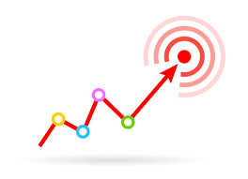
Objectives
Gathering knowledge about Machine Learning (ML) and Image processing technique for classification and detection of fruit.
Using appropriate machine learning algorithm to classify fruit and detect damage of fruit from a fruit dataset.
Accuracy rate can be improved than the previous researches.
Picture courtesy: Objectives-about, neptune-project.eu

Slide 8

Applications
Identification of fruit.
Detection damage of fruit.
Picture courtesy: Free open Book Icon, chittagongit.com

Slide 9

Contribution
We will apply a huge amount of dataset different types of fruits.
We will combined numerous method to get a better result such as SVM, LR, LDA, KNN, CART, RF, NB.(classification & Detection)
Picture courtesy: Humanergy.com

Slide 10
Related Works
1. Mureşan, Horea, and Mihai Oltean. "Fruit recognition from images using deep learning." Acta Universitatis Sapientiae, Informatica 10, no. 1 (2018): 26-42.
Contribution:
The Convolutional Neural Networks (CNN) gives better accuracy in different scenario.
Achieved accuracy between 91.91% - 95.41%
They introduced a high quality of dataset.
TensorFlow is used library in order to classify the images.
Limitation:
This is a more time consuming process

Slide 11
Related Works(cont.)
2. Bhange, Manisha, and H. A. Hingoliwala. "Smart farming: Pomegranate disease detection using image processing." Procedia Computer Science 58 (2015): 280-288.
Contribution:
k-means algorithm used for clustering and SVM for training and classification.
82% accuracy of identifying pomegranate disease
3. They proposed a web based tool
Limitation:
Worked with a small dataset.
Worked with only one fruit.

Slide 12
Related Works(cont.)
3. Awate, Ashwini, Damini Deshmankar, Gayatri Amrutkar, Utkarsha Bagul, and Samadhan Sonavane. "Fruit disease detection using color, texture analysis and ANN." In 2015 International Conference on Green Computing and Internet of Things (ICGCIoT), pp. 970-975. IEEE, 2015.
Contribution:
Artificial Neural Network (ANN) concept is used for pattern matching and classification of diseases.
OpenCV library is applied for implementation.
K-means clustering method is applied for image segmentation.
Achieved 90% accurate result.
Limitation:
Find the disease of fruit but not the damage.
Worked with only three fruits.

Slide 13
Proposed Method (Classification/Detection)
Load Image Test/ Train Dataset
Train Fruit Image
Test Fruit Image
Feature Extraction
Split the training & Testing Data
Train with SVM, KNN, RF, LDA, LR
K-flod Cross Validation
Combined All Model
Classification

Slide 14
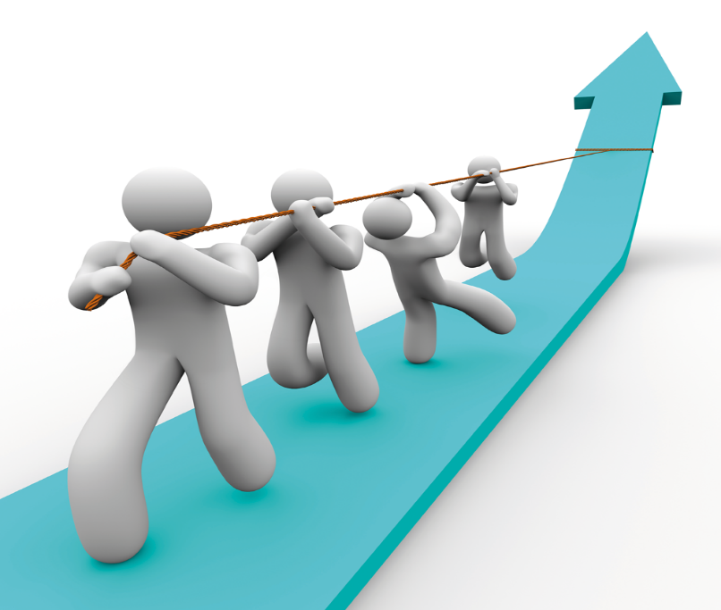
Future Works
Collecting data set and extract them.
Discress detect
Deep Learning
Implement the proposed methods.
Acquire a better accuracy rate.
Picture courtesy: http://www.sclance.com

Slide 15
Conclusion
Machine learning and image processing techniques will be very effective to classify and detect of fruit damage.
Our system will helps farmers to increase their productivity and yield with the help of automating tasks in garden/farm.
The more using of a large dataset will give better accuracy.

Slide 16
References
Mureşan, Horea, and Mihai Oltean. "Fruit recognition from images using deep learning." Acta Universitatis Sapientiae, Informatica 10, no. 1 (2018): 26-42.
Bhange, Manisha, and H. A. Hingoliwala. "Smart farming: Pomegranate disease detection using image processing." Procedia Computer Science 58 (2015): 280-288.
Awate, Ashwini, Damini Deshmankar, Gayatri Amrutkar, Utkarsha Bagul, and Samadhan Sonavane. "Fruit disease detection using color, texture analysis and ANN." In 2015 International Conference on Green Computing and Internet of Things (ICGCIoT), pp. 970-975. IEEE, 2015.

Slide 17

DO YOU HAVE
ANY
QUESTIONS ?

Slide 18
Thank you , everyone!

